Slide 1
Introduction to Active Record Validation in Ruby

Slide 2
INTRODUCTION
Active Record is the Object-Relational Mapping (ORM) layer in Ruby on Rails, a popular web application framework. It provides a set of tools to interact with a database and allows developers to define models representing database tables. Active Record validation is a feature in Ruby on Rails that ensures data integrity by validating the data before it is saved to the database. This helps maintain consistent and accurate data in the application.

Slide 3
Active Record
Active Record is a design pattern and a part of the Ruby on Rails web application framework. It is an Object-Relational Mapping (ORM) technique that allows developers to interact with a database using object-oriented programming principles.
Key features of Active Record include:
1. Model-View-Controller (MVC) Architecture
2. Object-Relational Mapping
3. CRUD Operations
4. Data Validations
5. Associations
6. Callbacks

Slide 4
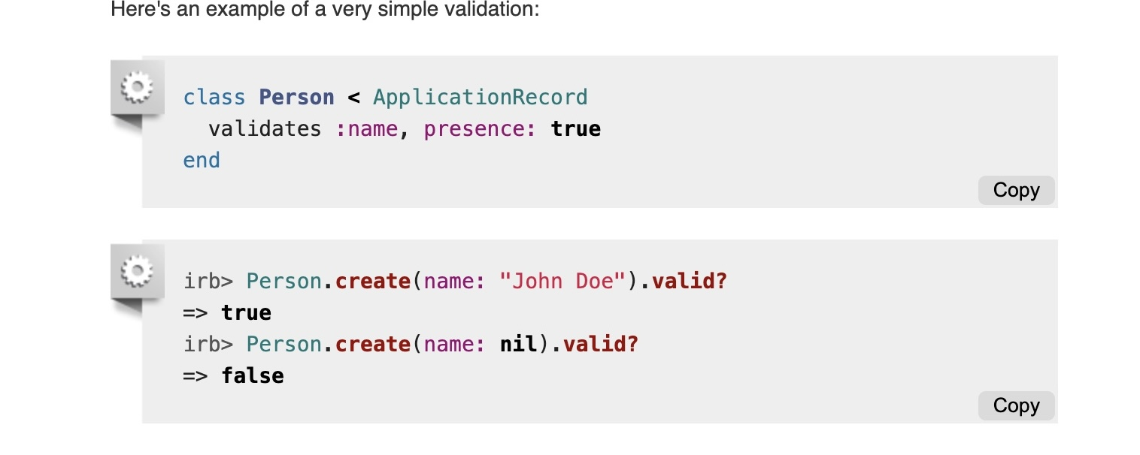
Validation Overview

Slide 5
When creating an Active Record model in Rails, you can specify various validations that the model's attributes must satisfy. These validations are typically defined in the model class and are executed before the data is persisted to the database.
Here are some common Active Record validations in Ruby on Rails:
Presence Validation: Ensures that a specific attribute is not empty or nil.
Length Validation: Validates the length of an attribute, ensuring it falls within a specified range.
Numericality Validation: Checks if an attribute is a valid number.
Format Validation: Validates an attribute against a regular expression pattern.
Uniqueness Validation: Ensures that the attribute value is unique among all records in the database.
Inclusion/Exclusion Validation: Validates that an attribute's value is included or excluded from a predefined set of values.

Slide 6
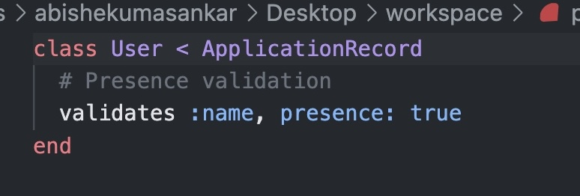
Presence Validation
Presence validation is a way to check whether a specific field or attribute in a data record contains a value. It ensures that the field is not left empty or blank when saving data to a database, helping maintain data integrity and preventing incomplete entries.

Slide 7
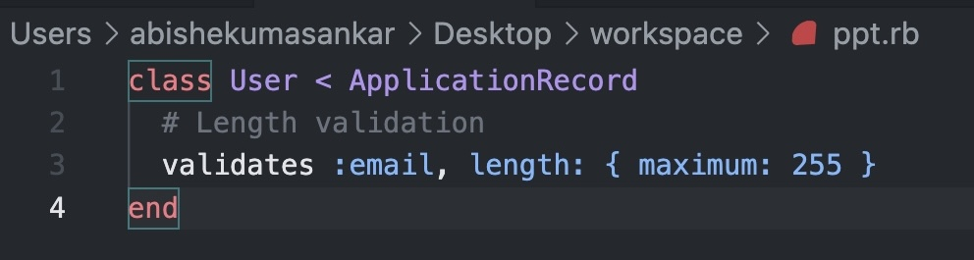
Length Validation
Length validation checks the size of a field or attribute in a data record, ensuring it meets specified minimum and/or maximum requirements. It helps maintain consistent and appropriate data in the database by preventing entries that don't comply with the defined length constraints.

Slide 8
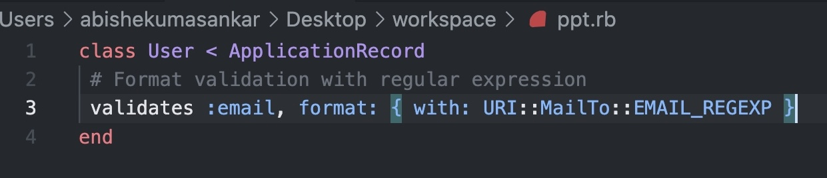
Format Validation
Format validation ensures that a field in a data record follows a specified pattern, such as email addresses or phone numbers, maintaining data integrity and consistency. Invalid formats are blocked from being saved to the database.

Slide 9
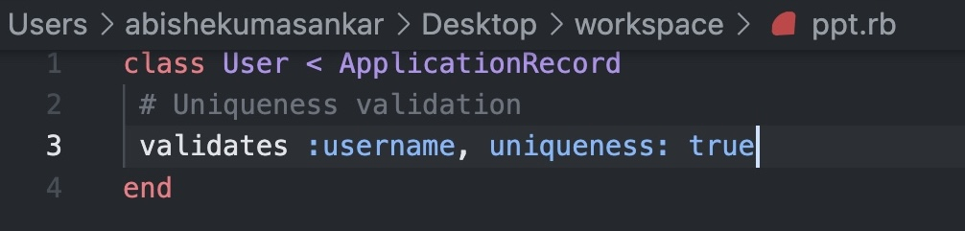
Uniqueness Validation
Uniqueness validation ensures that a specific attribute in a data record is unique, preventing duplicate entries in the database. It helps maintain data accuracy and consistency by enforcing uniqueness for important fields like usernames or email addresses.

Slide 10
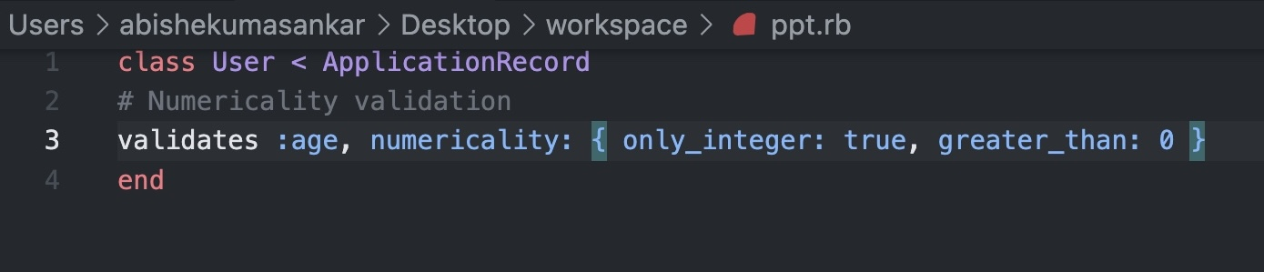
Numericality Validation
Numericality validation ensures that a specific attribute in a data record contains a valid numeric value, preventing non-numeric data from being saved to the database. It helps maintain data accuracy and is commonly used for fields like prices, quantities, and ages.

Slide 11
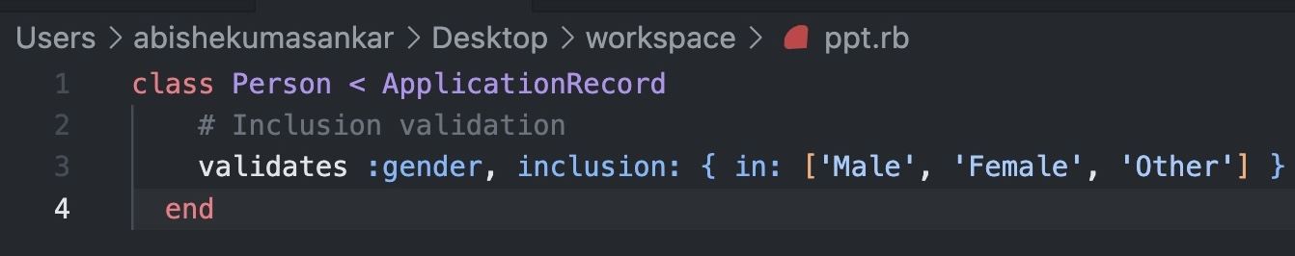
Inclusion/Exclusion Validation
Inclusion Validation: In inclusion validation, developers specify a list of valid values that the attribute's value must belong to. This means that the attribute's value must match one of the allowed values to pass the validation. If the value does not match any of the specified allowed values, the validation will fail, and the data won't be saved to the database.
Example: Let's say you have a "Gender" attribute in a "User" model and want to ensure that it can only be "Male," "Female," or "Other." By applying inclusion validation with the allowed values ["Male", "Female", "Other"], any other value will be considered invalid.

Slide 12
Inclusion/Exclusion Validation
Exclusion Validation: In exclusion validation, developers specify a list of values that the attribute's value must not be. This means that the attribute's value must not match any of the values listed to pass the validation. If the value matches any of the specified excluded values, the validation will fail, and the data won't be saved to the database.

